Slide 1
Application Layer Traffic Optimization (ALTO)
Presented by Ole Algoritme

Slide 2
ALTO Presentation Overview
What is ALTO?
What is ALTO trying to solve?
ALTO use-cases
IETF ALTO RFCs
The ALTO architecture and Protocol

Slide 3
What is ALTO?
ALTO is an acronym for Application-Layer Traffic Optimization
ALTO is an HTTP based client/server protocol (RFC 7285)
JSON encoded Request/Response over a REST-ful web API
Main use-case initially meant for Service Providers
Internet Service Providers, Network Providers, Content Delivery Networks
ALTO is an active IETF workgroup
Established in November 2009

Slide 4
What is ALTO trying to solve?
01
Provide an abstract definition for how Peer-to-Peer applications (+ others) can be more network aware and decide which endpoint it fetches data from
02
Reduction of Service Provider network congestion and costs due to random content fetching across networks
03
A better user experience, where users automatically get data from the “Most Optimal” endpoint instead of fetching it randomly across the globe
Notes:
01. Provide an abstract definition for how distributed applications can decide which endpoint it fetches data from Around 10-15 years ago, Service Providers were blocking Peer-To-Peer Network traffic. This was due to the network traffic looked erratic and did not really make sense to the Service Provider networks. It appeared as though they were under attack. - WHICH was a common way of DDoSing back in the day, with for example file-sharing P2P clients 02. Reducing the Service Provider network congestion and costs - Networks were being congested because of poor network traffic routing being done in the Application Layer - Why fetch the data from ASIA when the exact same data is hosted in your network? 03. ALTO tries to improve the User Experience by getting data from the “MOST OPTIMAL” endpoint when using for example Peer-To-Peer based applications. - reducing the time the user spends on fetching his much and urgently needed data. - So with an ALTO implementation one can say that ALTO is saving Bob some time, which he can spend with his kids instead of across-the-globe data fetching.

Slide 5
ALTO use-cases
Peer-to-Peer Applications
P2P File-sharing
P2P Video Streaming
Deployments in CDN and ISP networks
Reduce latency, congestion and cost
Improve QoE
Improve QoS

Slide 6
IETF ALTO RFCs
OCT 2009
SEP 2012
SEP 2014
NOV 2014
OCT 2016
OCT 2017
Requirements
Base Protocol
Cross-Domain Server Discovery
Deployment Considerations
Multi-Cost ALTO
Problem statement
RFC 5693
RFC 6708
RFC 7285
RFC 7286
RFC 7971
RFC 8189
FEB 2020
NOV 2020
NOV 2020
Problem description
Incremental Updates using SSE
ALTO Cost Calendar
RFC 8686
RFC 8895
RFC 8896
Notes:
RFC 5693: Problem statement
RFC 6708: Requirements Noted
RFC 7285: Protocol defined
RFC 7286: Cross-Domain Server Discovery RFC 7971: Deployment Considerations RFC 8189: Multi-Cost ALTO
RFC 8686: Problem description
RFC 8895: Incremental Updated using SSE (Server-Sent Events)
RFC 8896: ALTO Cost Calendar CONCLUSION:
By looking at the all the contributions made by the ALTO IETF WorkGroup, one can assume the ALTO IETF WG only works during winter time

Slide 7
IETF ALTO RFCs
CDNI Extension
CDN Interconnection Advertisement
A set of protocols to interconnect multiple CDNs
Defines a new ALTO Service to provide CDNI footprint and capability advertisement interface (FCI)
ALTO Path Vector Extension
Provides detailed abstracted routing information using ANEs
ALTO Performance Cost Metrics
Provides a set of new network performance metrics
Network delay, jitter, packet loss, hop count & bandwidth measurement
Unified Properties for the ALTO protocol
Abstracts the concept of an ALTO Endpoint by presenting those as “property maps”
Extensions in Active Drafts Status:
Notes:
CDNI:
Passed the WorkGroup in 2020

Slide 8
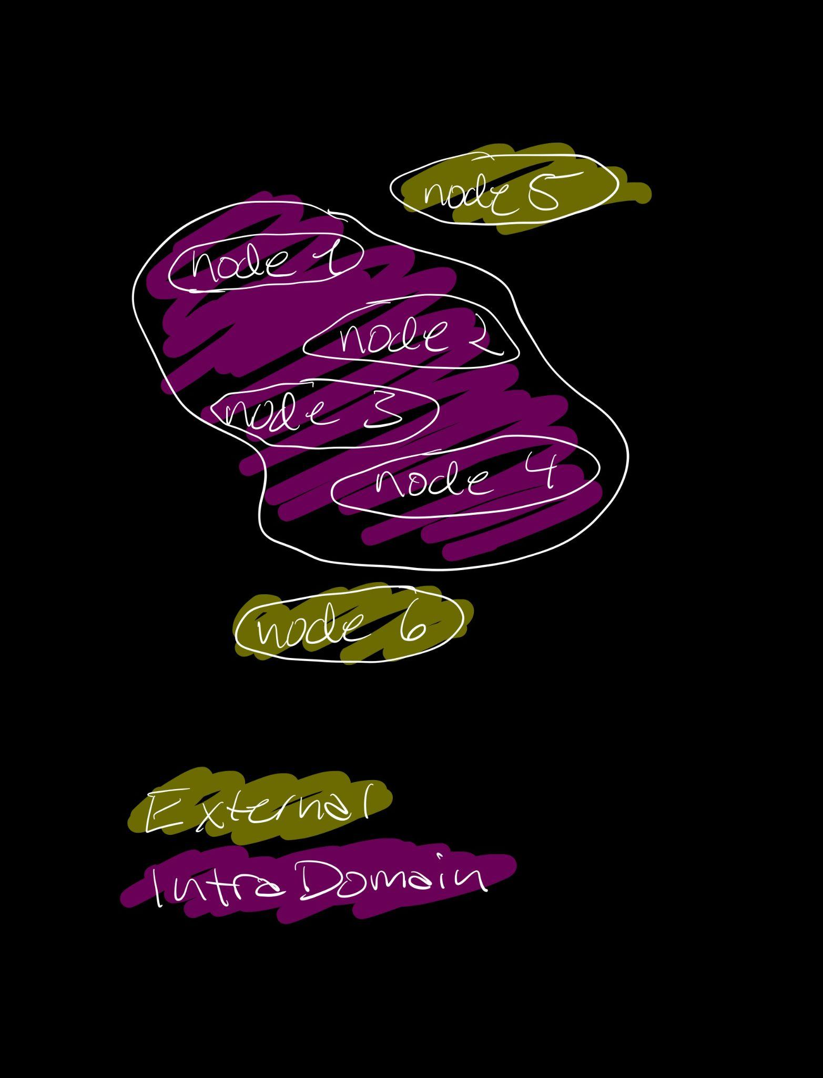
ALTO Architecture
“My Internet View”
The ALTO Server
Is an HTTP REST-ful based server deployed in an arbitrary network
Responds to queries from ALTO Clients to give better options in peer selection
Each ALTO Server maintains a “My Internet View”
My Internet View is an allocation of
External Node Sets
IntraDomain Node Sets

Slide 9
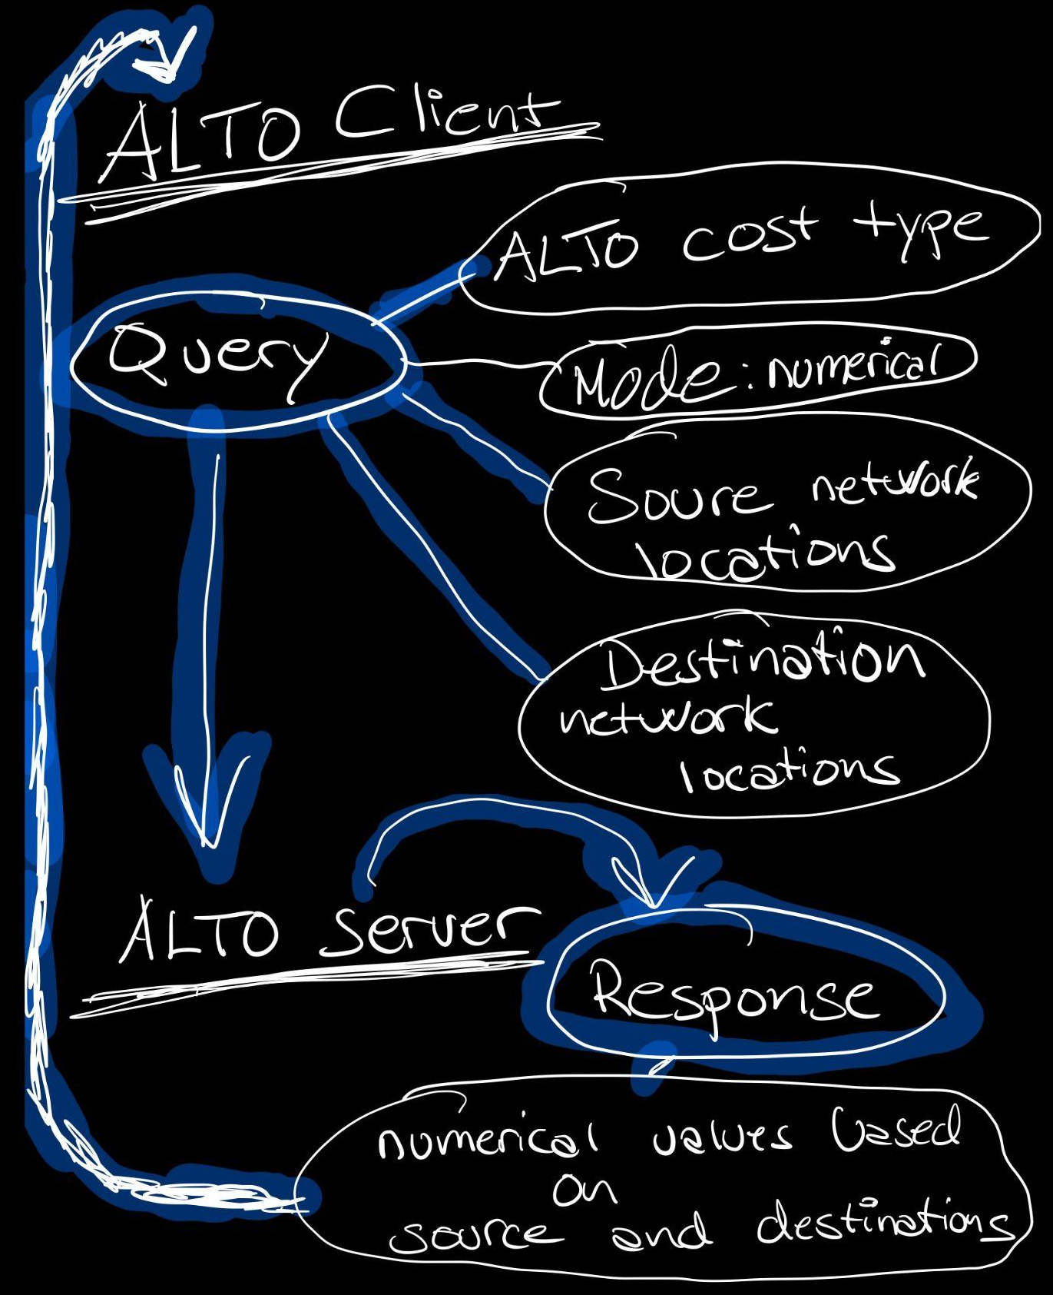
ALTO Architecture
The ALTO Client
Sends Query to ALTO Server
Query Cost Maps
ALTO Client uses the results to make peer gathering decisions
Notes:
Cost Types - indicates what which cost type
Path costs have attributes:
o Cost Metric: identifies what the costs represent
o Cost Mode: identifies how the costs should be interpreted (numerical in this case) Cost Metric
Can represent air kilometers, hop count, or abstract routing costs.
Cost metrics are indicated in protocol messages as strings.

Slide 10
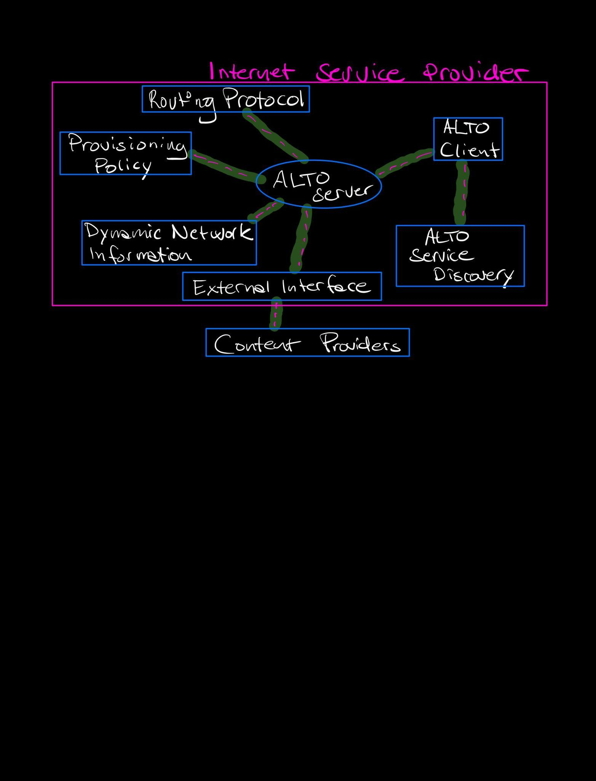
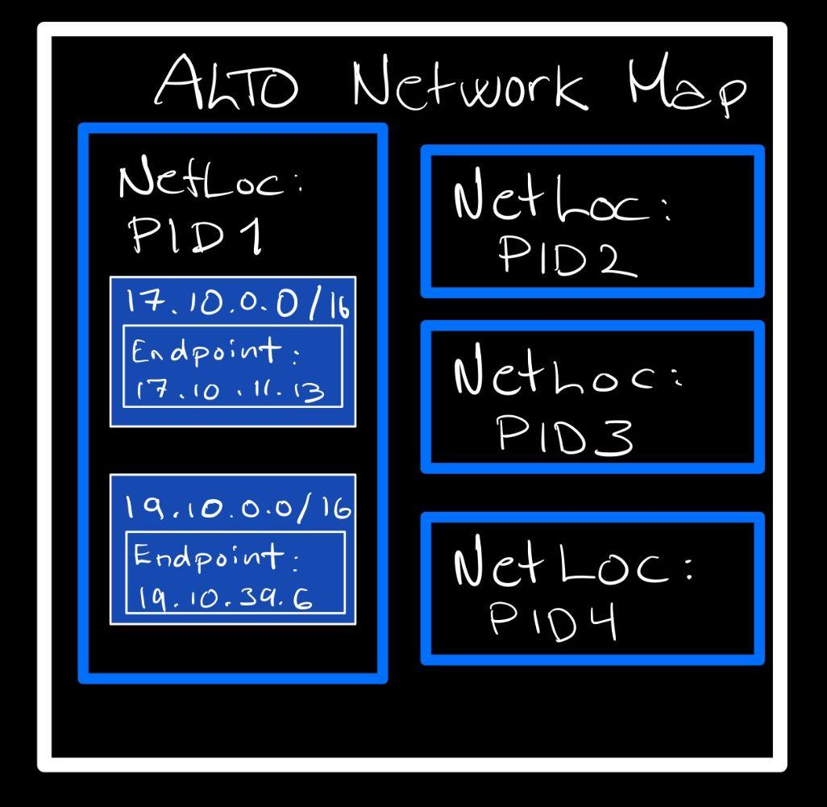
ALTO Architecture
High level overview of an ALTO deployment at an ISP
IRD contains Resources available
Communicate with ALTO Server
HTTP Get ResourceType
HTTP Response Network Map
IRD Response
Request IRDs
Notes:
As seen in this picture, we can see that an ALTO Server deployed in a network The ALTO Server can aggregate information from multiple systems to provide a more abstract and unified view that applications can take advantage of.
PID: Provider-defined network location Identifiers (abstraction of Endpoint Groupings)
IRD: INFORMATION RESOURCE DIRECTORY IRD: List of available information resources provided by an ALTO Server ALTO Client: -> request IRDs -> ALTO Service Discovery -> returns ALTO URI ALTO Client: -> HTTP Get ResourceType ALTO Server: -> HTTP Response Network Map Resources (Requested over RESTful HTTP):
Network Map
Path Rating
Cost Map
++++

Slide 11
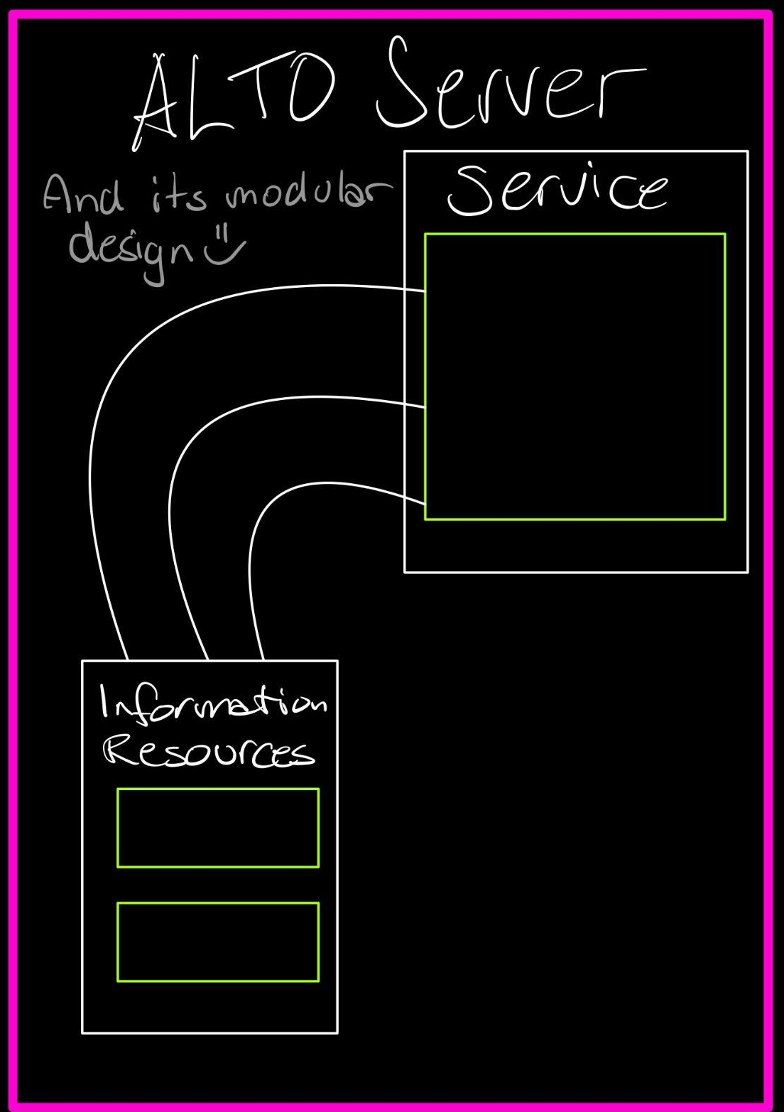
ALTO Protocol
P2P example using ALTO base Protocol (RFC7285)
P2P Application
With Embedded ALTO client
MAP Service
Get Network Map
Get Cost Map
Peer Gathering
Network Map
Select Peers
Cost Map
Connect to peers
Notes:
- The ALTO Protocol is designed with modularity in mind. - The design divides ALTO information publication into multiple ALTO Services
P.I.D = Provider-defined Identifier (abstract grouping) 1. The P2P app requests network map cover all PIDs from ALTO Server in an ISP deployment.
2. The P2P app requests cost map providing path costs amongst all PIDs from ALTO Server in an ISP deployment. The cost map defaults to numerical costs.
3. The P2P app gathers peers from sources such as peer exchanges, other P2P clients, DHTs and P2P trackers.
4. The P2P app uses the provided ALTO information as part of the algorithm for selecting the new peers and connecting to them.

Slide 12
ALTO Presentation
That’s all, folks!
Thank you! Questions?

